Slide 1
Higher Biology
Symbiosis
Mr G R Davidson

Slide 2
Symbiosis
Symbiosis is an intimate ecological relationship between organisms of 2 different species that live in direct contact with each other.
These relationships have taken millions of years to co-evolve and if a change happens to one of the partners, it is likely to have a serious effect on the survival of the other.

Slide 3
Symbiosis
There are 2 types of symbiosis:
Parasitism where one organism (parasite) benefits at the expense of the other (host) which can often be damaged.
This shows dependence since the parasite depends on the host.
Mutualism where both organisms benefit from the relationship.
This shows interdependence since both organisms depend on each other.

Slide 4
Parasitism
Parasites survive at the expense of the host and this can result in the host losing energy or materials to the parasite, or the host being harmed in some way.
Parasites often have a limited metabolism which means they cannot survive outwith the host, e.g. tapeworms lack a digestive system since the host has already digested the food.

Slide 5
Parasitism
There are some parasites which live and feed inside their host, e.g. liver fluke, tapeworm, etc..
There are some parasites which live and feed outside their host, e.g. mosquito, fleas, etc..

Slide 6
Parasitism
Parasites can be transmitted to new hosts using a variety of mechanisms such as:
Direct contact, e.g. head lice
Release of resistant stages where the organism passes through a stage where it is able to survive adverse conditions until a new host becomes available, e.g cat fleas.
Use of a vector, e.g. mosquito carrying Plasmodium, the organism responsible for malaria.

Slide 7
Parasitism
There are two types of life cycle in parasites:
In a direct life cycle, eggs are produced and passed to a new host of the same species.
In an indirect life cycle the parasite uses a primary or final host species as the site of reproduction. Prior to this stage it involves the use of a secondary or intermediate host where the parasite will develop to a new stage.

Slide 8
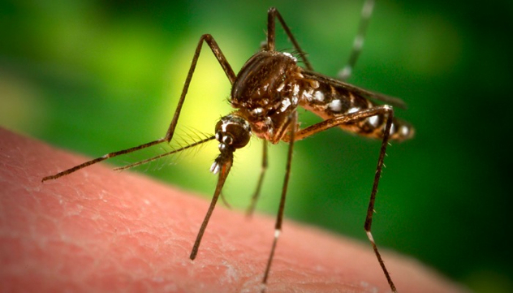
Parasitism

Slide 9
Mutualism
Mutualism is a relationship between 2 organisms where they both benefit.
Many herbivores do not have the ability to digest the cellulose of the plant cell walls.

Slide 10
Mutualism
Instead they have cellulose-digesting bacteria in their gut.
This benefits both the herbivore, as it gets the food digested for it, and the bacteria get a nice safe, warm and moist place to live.

Slide 11
Mutualism
Coral polyps also share a mutualistic relationship with an algae called Zooxanthella.
The algae can photosynthesise and this provides a food source for the polyp, while the polyp provides a secure habitat and a source of nitrogen which the algae uses for protein production.

Slide 12
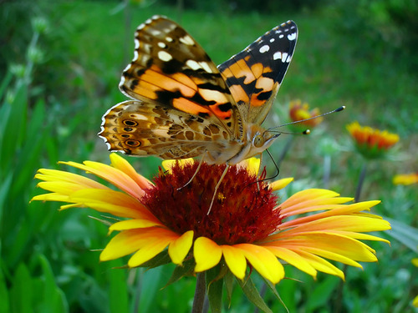
Mutualism

Slide 13
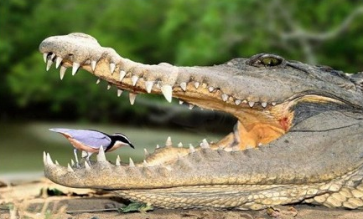
Mutualism

Slide 14
Symbiotic Origin of Chloroplasts and Mitochondria
Chloroplasts and mitochondria are cell organelles found in eukarytes.
It is thought that they originated as free living prokaryotes.
These then became engulfed into larger cells developing a mutualistic relationship with them.

Slide 15
Symbiotic Origin of Chloroplasts and Mitochondria
There is evidence to support this theory in the form of:
Both have their own circular DNA similar to prokaryotes.
Both have ribosomes similar to prokaryotes.
Both are similar in size to prokaryotic cells.
Both replicate in a similar fashion to prokaryotes.
Both have inner membranes with electron transport systems and enzymes similar to prokaryotes.

